Slide 1


Your online mental
wellbeing community
kooth.com
Notes:
PLEASE READ CAREFULLY‼️
Presentation guidelines:
Personalising this presentation:
This is a view only google slides template that you won’t be able to edit or personalise.
To personalise this presentation, simply select “File” and then “Make a copy”. You’ll then be able to start personalising the slides that need to be personalised.
Speaker notes:
The slide guidelines and speaker notes in this presentation are designed to support you, not you to confine the way you deliver your presentation.
As long as you feel like you’ve covered the main points, please feel free to adapt the speaker notes in each slide to best suit you, your audience and the time you have.
You might want to turn them into shorter bullet points or perhaps even have them on your own separate document.

Slide 2

Emily Roberts
She/her
A bit
about me.
Notes:
OPTIONAL SLIDE DEPENDANT ON THE TIME YOU HAVE
This is an opportunity to add a personal touch to your presentation. You can use this space to write up a few sentences to introduce yourself. Some things you might want to discuss could be:
Your name
Your gender pronouns (he/him, she/her, them/they)
How long you’ve been at Kooth
An easy to understand summary of what you do at Kooth
What you do to unwind/look after your wellbeing
Why you chose to work for a mental health service

Slide 3

Where do you go when you need to talk to someone?
Notes:
OPTIONAL SLIDE DEPENDANT ON THE TIME YOU HAVE
Slide guideline: This slide is an opportunity to ask a rhetorical question to the audience that gets them thinking about what their current support system looks like. Feel free to adapt this question to your preference but this is an example that is currently used that you are welcome to use.
This is not a question to be answered out loud, but one to think about in your own mind.

Slide 4

Here are some
things we’d like
you to always remember about Kooth…
Notes:
Slide guideline:
This slide is a prequel to the following slides which will outline some things we’d like the CYPs you’re presenting to to remember about Kooth.

Slide 5

It’s completely free.
Notes:
Speaker notes - Here are some prompts that might be useful to discuss. Feel free to pick and choose the ones you’d like to emphasise the most.
There are no hidden costs to using Kooth.
Every part of Kooth is completely free for you to use.
We feel passionate that mental health and wellbeing support is a right you all deserve.
The quality of support you receive will not be greater or lesser based on how much money you have.

Slide 6

You don’t need to be referred by anyone.
You can sign up anytime.
Notes:
Speaker notes - Here are some prompts that might be useful to discuss. Feel free to pick and choose the ones you’d like to emphasise the most.
Unlike some other more traditional mental health services, you won’t need to be referred by an adult or a formal GP referral to start using Kooth.
You can sign up whenever you like and in any place that feels comfortable to you.
Signing up is quick and easy.
This means you can start accessing support in minutes and do it on your own terms.

Slide 7

Bullying and trolling can’t take place
on the site.
Notes:
Speaker notes - Here are some prompts that might be useful to discuss. Feel free to pick and choose the ones you’d like to emphasise the most.
Because our site is pre-moderated it means that bullying comments or hate speech won’t be approved to appear on the site.
So you can trust that Kooth is a safe and non judgemental place.

Slide 8

You’re anonymous
to us
Notes:
Speaker notes - Here are some prompts that might be useful to discuss. Feel free to pick and choose the ones you’d like to emphasise the most.
This can be covered off very briefly as the following slides gives great detail about what being anonymous really means on Kooth.
If you’re short on time, you can give a brief summary on this slide and then skip the more detailed “what we mean by anonymous” slide.
IMPORTANT TO EXPLAIN: We will only ask for personal details if we felt that you weren't safe so that we can get the right support in place for you, which might be a local agency or other helpful organisations.

Slide 9

No problem is ever
too small at Kooth
If it’s on your mind, we’re here to help. Some of the feelings or difficulties we can support you with could include:
Stress
Anxiety
Friendships
Life at home
Exam or coursework
pressures
Eating difficulties
Loneliness
Body image concerns
Anger
Confidence
Big changes
Social media
Notes:
⚠️ Slide guideline
Please feel free to adapt the list of article examples to best suit your audience i.e based on their ages:. 10-16 or 18-25.

Slide 10

Kooth isn’t an app
so you won’t be able to find us on any app stores
Notes:
Speaker notes:
A frequent misconception is that Kooth is an app. We’d like to clarify that we’re not an app.
But this means we won't appear in your app downloads which we’ve heard can sometimes make people feel safe in knowing their use of Kooth has that extra layer of privacy and confidentiality.

Slide 11
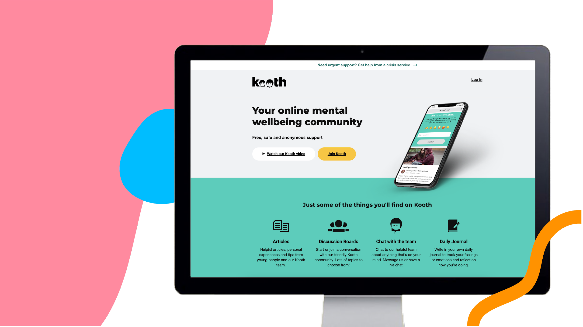
Click on the
‘Join Kooth’
button to
get started
Notes:
Speaker notes:
Once you’ve landed on kooth.com, you’ll probably notice a Join Kooth button which we’ve highlighted for you.
Simply click on the button and you’ll enter our sign up form.

Slide 12

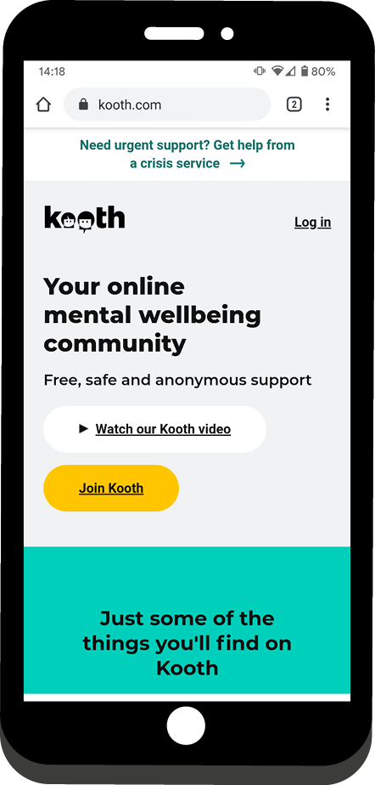
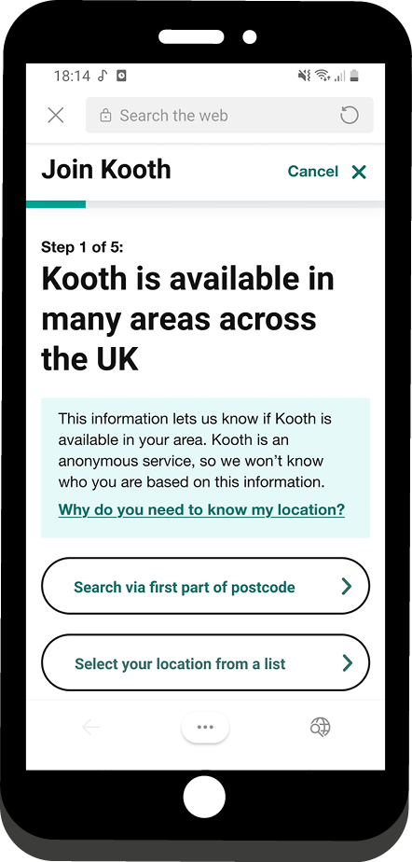
1. Select Join Kooth.
2. Sign up by postcode or
select your location from
our dropdown list.
How to sign up
Notes:
OPTIONAL SLIDE: IF YOU’VE PRESENTED THE SIGN UP FLOW VIDEO YOU CAN DISREGARD THE 3 SIGN UP SLIDES
Speaker notes:
You’re able to choose your local area by entering the first part of your home postcode.
Or you can find your local area by choosing from our dropdown list.

Slide 13
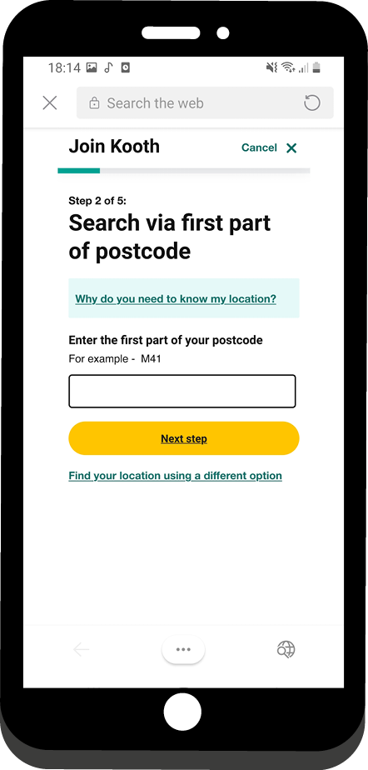
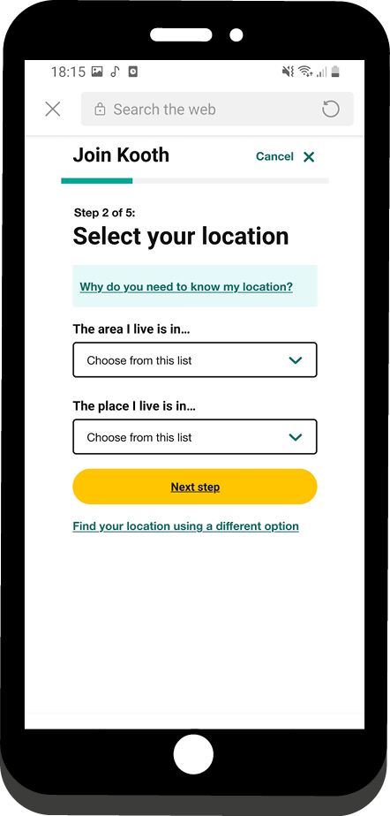
OR
3. Enter the first part
of your postcode.
4. Choose your area
from the dropdown.
Notes:
Speaker notes:
The first part of your postcode will likely be the first 2,3 or 4 letters. For example, if your postcode is NW6 4RN, simply enter NW6.
Or, using the drop down list, you can choose your area and then choose the place that’s closest to you.
Guidance to KEL ‼️: Please try and ensure you know the area/location and sub-location/place for whatever school or setting you’re presenting in and try to emphasise this to your audience

Slide 14

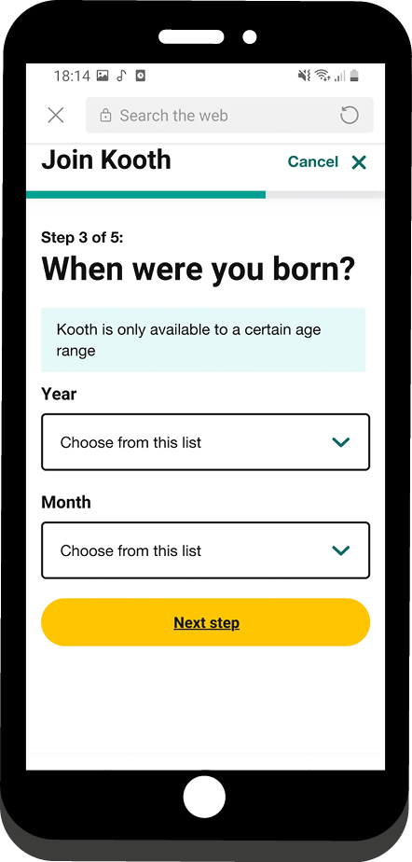
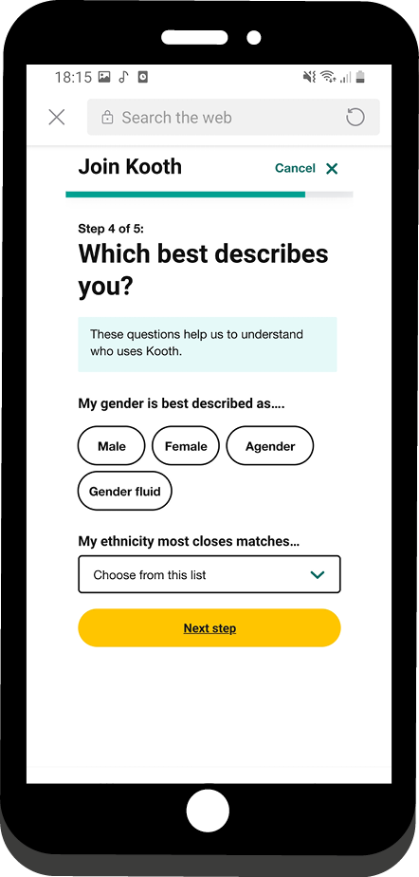
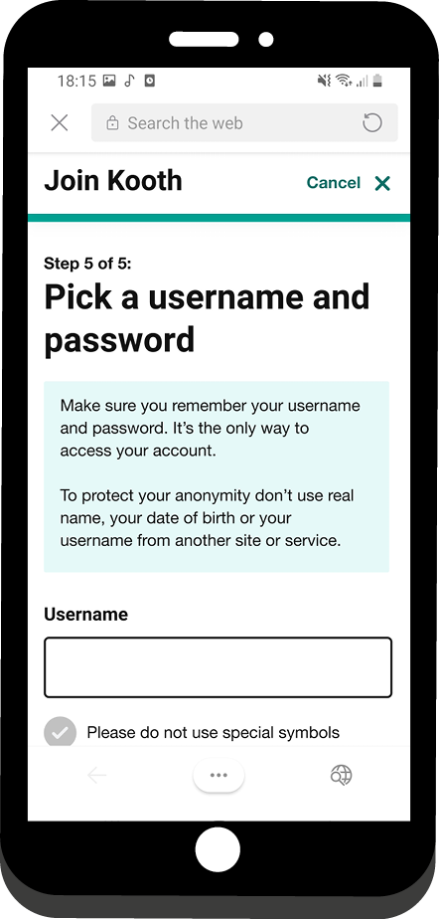
5. Select your month
and year of birth.
6. Select your gender
and ethnicity.
7. Create an
anonymous (not your
real name) username
and secure password.
Notes:
Speaker notes:
We ask for this information to make sure that any interaction we have with an individual is appropriate for them’, which gives some understanding as to why they are giving us this info.
Your username: Our tips
Avoid using your real name
And gamertags or social media handles
Any personal information
Also avoid any swear words or inappropriate language
Keep your password in a safe place because we can’t send you a new one.
This is because we don’t collect email addresses. We want to protect your identity but it does mean we cannot send you a password reset email.”

Slide 15

We offer a range of support options and you have complete control of what to use.

Slide 16

Professional
support
Self-directed
support
Community
support
Helpful articles
Live text-based chat
Send a message to our team
Activities
Journal Space and Goal Setting
Discussion boards
Live forums
Notes:
⚠️ Slide guideline
If you’re low on time, you can use this slide to outline and explain the different features on Kooth.
Conversely, if you’ve got we recommended using the time, the slides that cover each feature in more detail are highly useful.

Slide 17
Live text-based chat with a member of our team. We’re here to listen
Notes:
OPTIONAL SLIDE DEPENDANT ON THE TIME YOU HAVE
Speaker notes:
Here you can get professional support and advice via online chat sessions lasting up to 1 hour.
To request a chat, simply select “chat” on the homepage and then “join that chat queue”.
To clarify, when we say text-based chat, this means there are no voice calls or video calls involved when you speak with the Kooth team.
We try our best to chat with everyone, but if you are unable to get a chat right away, we recommend waiting a short while but if the wait is too long for you, try again another day or message the team inbox.
This is a helpful article but you’ll need to log-in to a test account to access it - https://www.kooth.com/members.html/magazine/articles/0a50664f-af65-499a-a9ae-767cef78cc78

Slide 18

Our team are
here for you
365 days a year
You can chat with us
during the following hours:
Monday - Friday
12pm - 10pm
Saturday and Sunday
6pm - 10pm
Notes:
Speaker notes:
We offer slightly reduced hours around the Christmas and New Year Period but still are here for you.
At busier periods, you may have not be able to enter a chat with someone right away and there may be a bit of a waiting time.
However, we recommend you explore other parts of Kooth whilst you wait.
This might include reading article, Contributing to a discussion board or even trying one of our mini activities.
We also recognise that engaging in a live chat may either not be available instantly or not be what you’re seeking.
If you feel like reaching out for support but prefer not to do this via a live chat session, then you can send a message to our team inbox and a member of our team aim to respond to you as soon as they can. They aim for 24-48 hours although this may vary during busy periods.
This would be in the same way you might send an email to someone and they’ll respond back to you when they can.

Slide 19
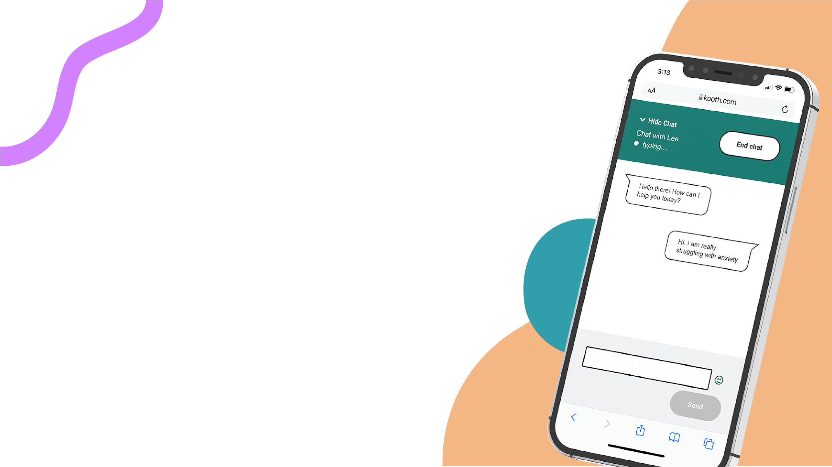
Your first chat session
When you first come to chat, we will talk with you about:
Understanding a little bit about you
Exploring your current difficulties and what's brought you to Kooth
Thinking together about the best way we can support you
Notes:
Speaker notes:
We will work with you to figure out the best way that Kooth can support you
This might be through ad hoc/when you feel like it drop in sessions in which you can have up to 1 hour per week or more structured, weekly sessions with the same named member of our team that you’ll work with over the duration of your sessions.
We’ll also discuss with you how you can make the most of other parts of the site to help you make the most of everything Kooth has to offer.
Essentially, your first chat is a chance for us to get to know you and to understand how we can offer you the support you need.

Slide 20
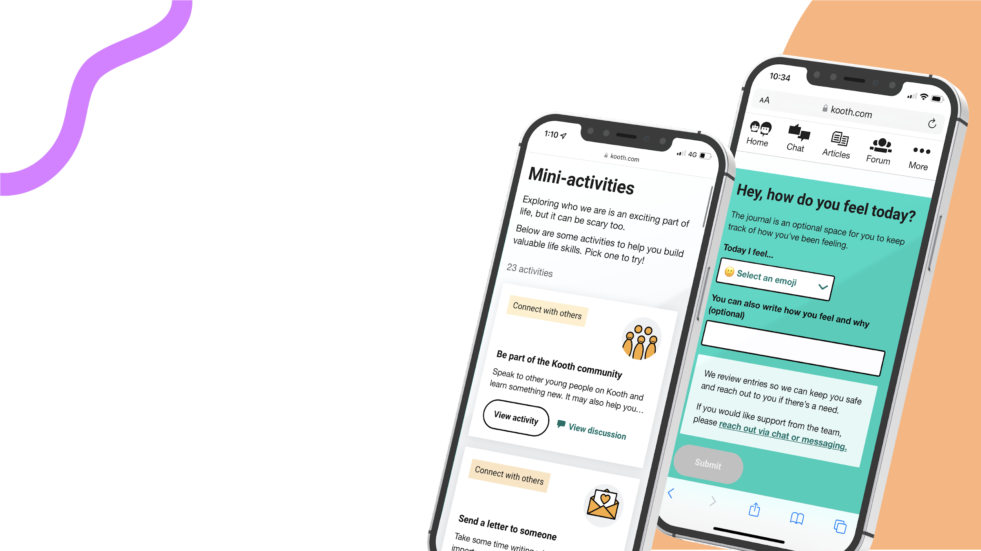
A range of self-help tools all in one place
You can use these tools at any time.
Options include:
Wellbeing mini activity hub
Journal space
Goal setting
Notes:
Speaker notes:
We recognise that engaging with someone from our team may not be what you’re seeking.
Our self-help options allow you to try out different parts of the site that are completely self directed by you.
You can try on of our 23 mini wellbeing activities which help you with things like connecting with others, managing emotions, building helpful habits and expressing yourself.
You can also keep track of how you’re feeling by using your own journal space.
Or you can try our goal setting exercise which help you keep track of things you might want to work on.

Slide 21

Find support from other
young people in our
discussion boards
and live forums
You can start or join any discussion and there’s lots of different topics to choose from!
Notes:
Speaker notes:
A discussion board is a thread that’s based on someone’s post. You can find a topic that’s interesting to you then follow along, leave a comment or you could also start your own discussion.
A live forum is similar to a discussion board but the discussion is moderated live, meaning you can talk to others across the country in live time on a different themed topic each week. Live forums take place on a rotating basis every Monday, Wednesday or Friday evening from 7:30-9pm
We want Kooth to be a safe space for everyone. Our site is pre-moderated, which means that our moderators check everything before it's published to the site.
This means that sometimes we will edit a submission, or not publish it at all, if it contains something that might cause distress for someone else. But we will message you directly if we’re not able to publish you post or comment. Please bear with us for this process, as on busier days it can take some time between submitting your post and seeing it go up on the live site. But because of this it means it means we can keep Kooth a safe space for everyone.
You also won’t be able direct message other young people on the site but instead you’ll be able to communicate and support each other via the comments section.

Slide 22
Choose from a range of helpful articles written
by both young people and our professional team
Notes:
⚠️ Slide guideline
If you are low on time, you can cover off some types of article categories in this slide and then skip the next slide.
Speaker notes:
We have thousands of helpful articles covering a range of topics.
Some of these articles are written by our very own users whereas others will be written by Kooth’s own content team.
You’ll be able to tell if the article has been written by another young person or a member of our team because members of our team will have their first name appear on the article whereas our users names will be anonymised usernames with different characters and symbols not first names.
So get writing and send us your stories, poems or articles.

Slide 23

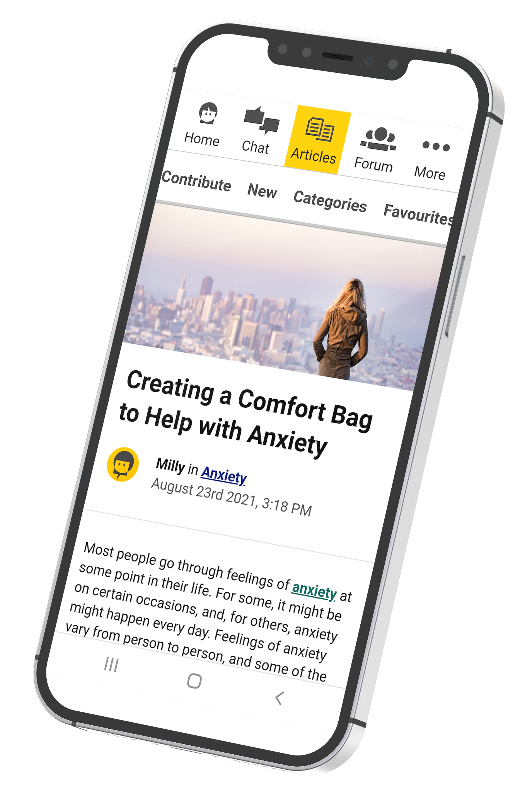
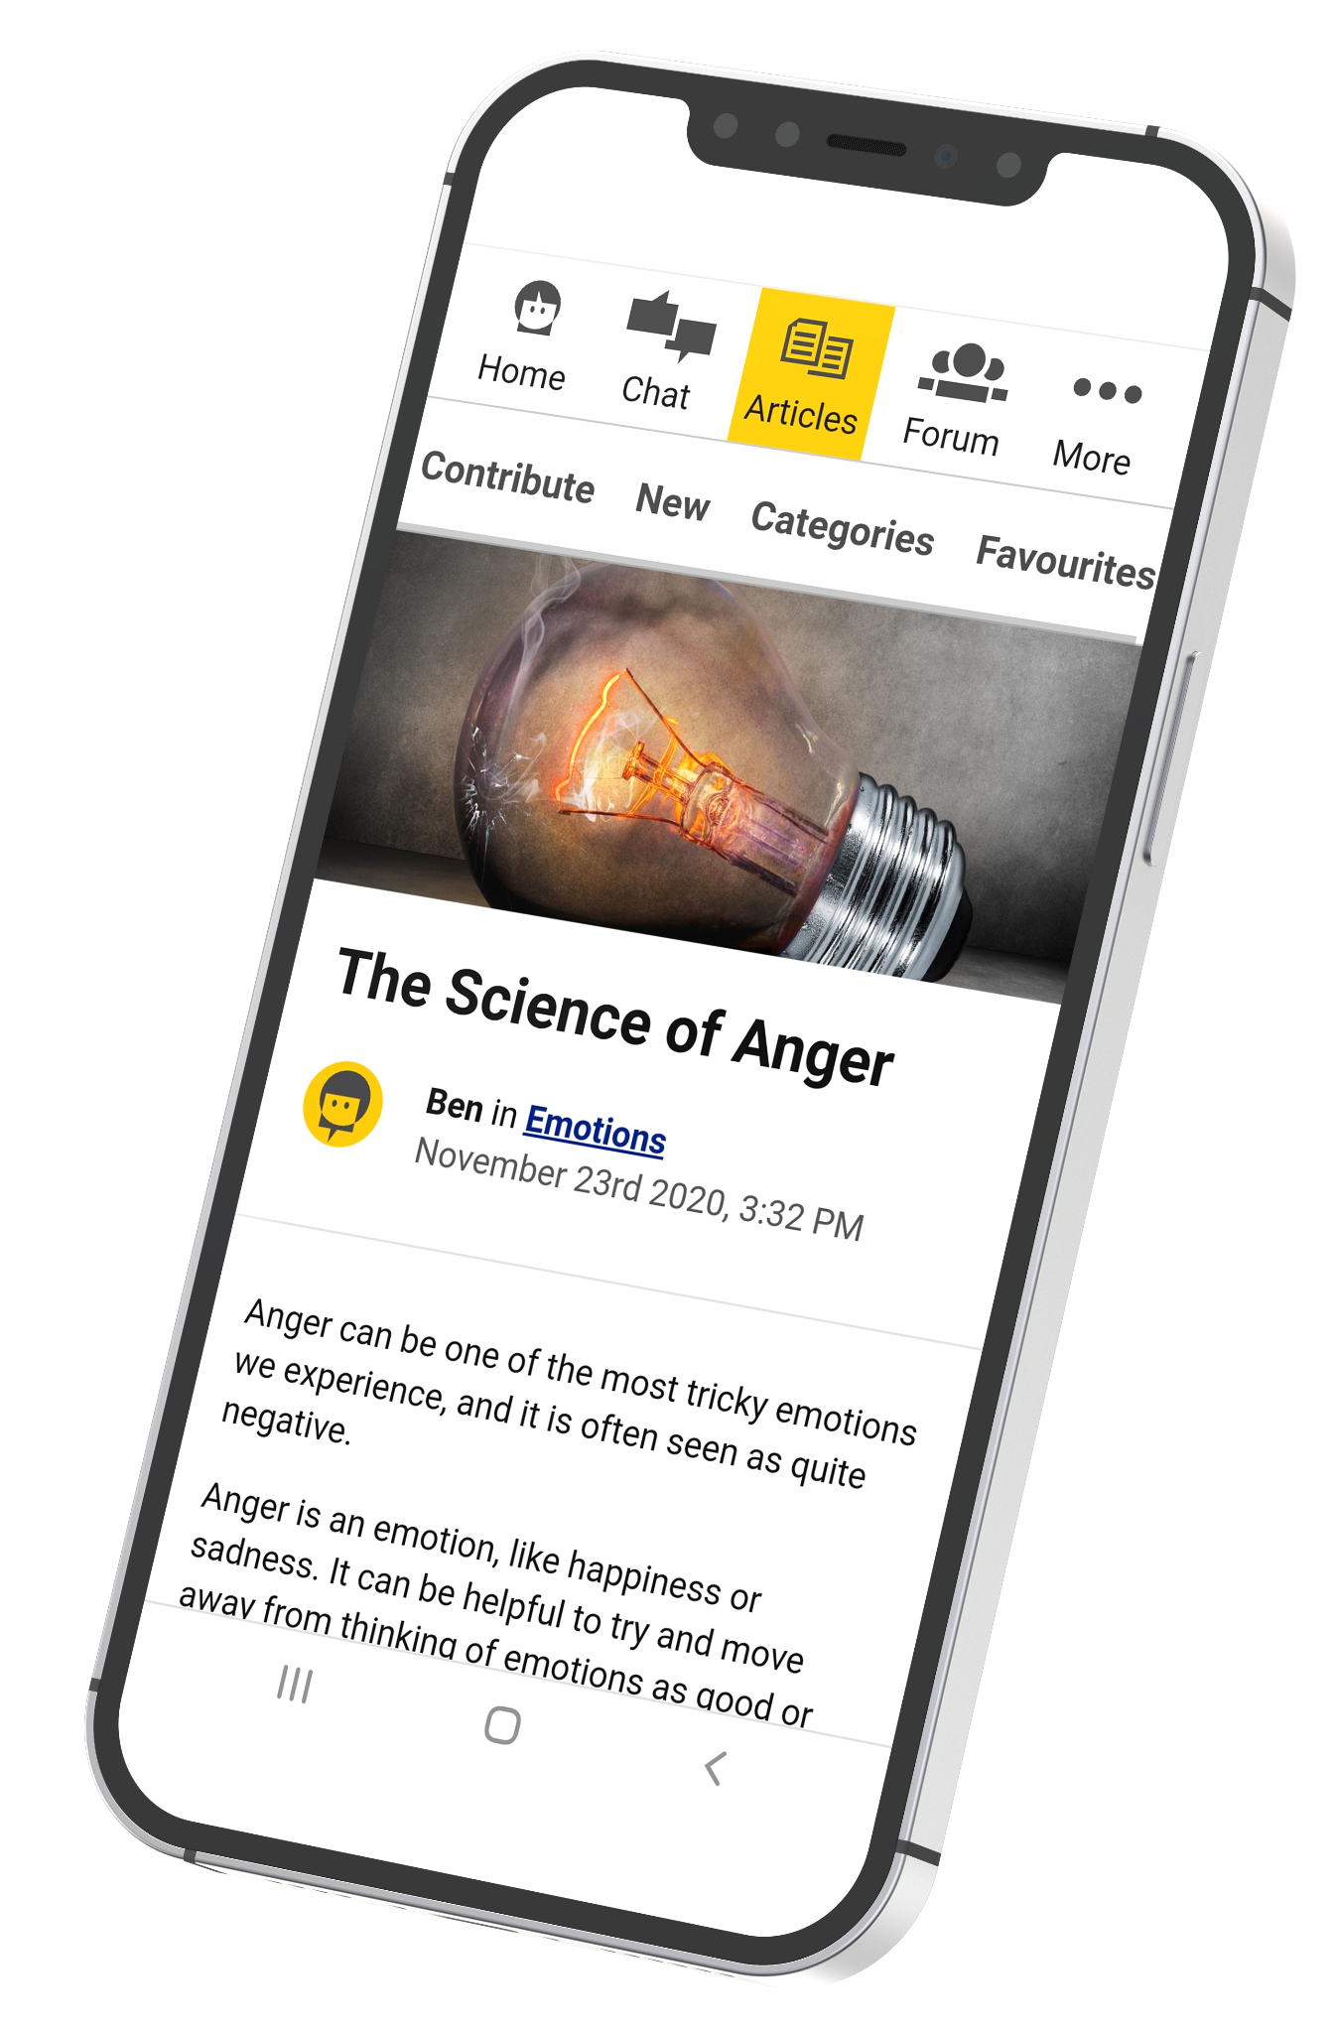
Article topics include:
Personal stories
Bullying
Relationships
Identity
Hobbies and interests
General health
and wellbeing
Notes:
OPTIONAL SLIDE DEPENDANT ON THE TIME YOU HAVE
Please also feel free to tweak the types of articles to best suit your audience based on their age range, gender identity, sexuality, ethnicity, religious beleifs etc.
Speaker notes:
You can try:
Writing your own articles
Reading articles written by others
Joining the discussion in the comments section

Slide 24

95%
of our users
would recommend
Kooth to a friend
Urgent support
page if you need it:
Simply visit
kooth.com/
urgent-support
You can
trust us
Our team are
real people who
want to listen
and help.
They’re not bots
Notes:
Speaker notes:
Urgent help: If you feel like you need urgent support, we highlight some crisis services that can help you on our urgent support page - You can access this at kooth.com/urgent-support.
Our team: Our team are real people who really care and want to listen and help. Although you’ll be engaging with them through a text based chat, we want to reassure you that our team are not bots who are sending automatic replies.

Slide 25

“I’m more able
to manage low periods in
my life.”
“I feel safe to explore my feelings.”
Notes:
OPTIONAL SLIDE DEPENDANT ON THE TIME YOU HAVE

Slide 26

“I’ve never felt pressured using Kooth. I’m in full control.”
“Kooth feels like a family and I can’t thank you enough.”
Notes:
OPTIONAL SLIDE DEPENDANT ON THE TIME YOU HAVE

Slide 27




Finding us outside
of Kooth.com
@kooth_uk
Kooth Podcast
Find us on Spotify and Apple Podcasts
Notes:
Speaker notes:
If you want to follow us off of the Kooth site, you can do this by following us on:
Our Instagram page @kooth_uk - Unfortunately, we won’t be able to engage with you or offer you any direct support from our Instagram account. Kooth.com is the place for you to go to access support.
Or, check out our Kooth podcast which you can find on Spotify and Apple Podcasts.

Slide 28


Everyone needs support sometimes - and if you do, we are here.
kooth.com
Notes:
⚠️ Slide guideline - Ending of presentation

