Slide 1

National Apprenticeship Week
‘Look Beyond’
3rd – 7th February 2020
Notes:
calling on young people to look beyond traditional routes into employment and explore the diversity of career options and industries now available to them through apprenticeships;
calling on employers to look beyond traditional hiring routes and shout about the value they already see from diversifying their workforce by employing apprentices
calling on parents and teachers to look beyond old preconceptions around apprenticeships, building understanding of the true value they bring, and sharing this with young people.

Slide 2





What are apprenticeships?
Earn a wage
Work for at least
30 hours per week
Study towards a
job related qualification
Contract of employment
including holiday pay
Real job with
real responsibilities
Notes:
Lots of people get confused about apprenticeships. That’s probably because they’ve been around for hundreds of years, but they’ve changed a lot in that time.
You will earn a wage – and it can be a really good salary too! We’ll talk more about money later on.
You will work for at least 30 hours per week and this will include paid time to complete your studies.
The employer will invest their time and money in helping you to gain qualifications and valuable new skills and experience. You will be given real responsibilities and expected to work hard, just like anyone else in the company.
You will also be supported by a training provider, who will help you achieve your qualifications and make sure you complete your apprenticeship.
Because it’s a proper job, you will also have a contract of employment, including holiday pay - exactly the same as any other member of staff.
It’s important to understand that an apprenticeship is a real job, with a real employer. You will spend time working alongside other people and learn from their experience. There’s a myth that apprenticeships are just like work experience, where you’re given basic tasks or asked to make the tea, but this isn’t the case.
An apprenticeship typically takes 1 to 4 years to complete (sometimes up to 6 for some areas like Solicitor).
The total duration will depend on the delivery model that your employer selects, the level and the subject you’re studying.
As a minimum, all apprenticeships must last for a minimum of 12 months.
It’s important to remember that apprenticeships aren’t the ‘easy option’.
Holding down a full time job and studying takes a certain skill, and it won’t be right for everyone.

Slide 3
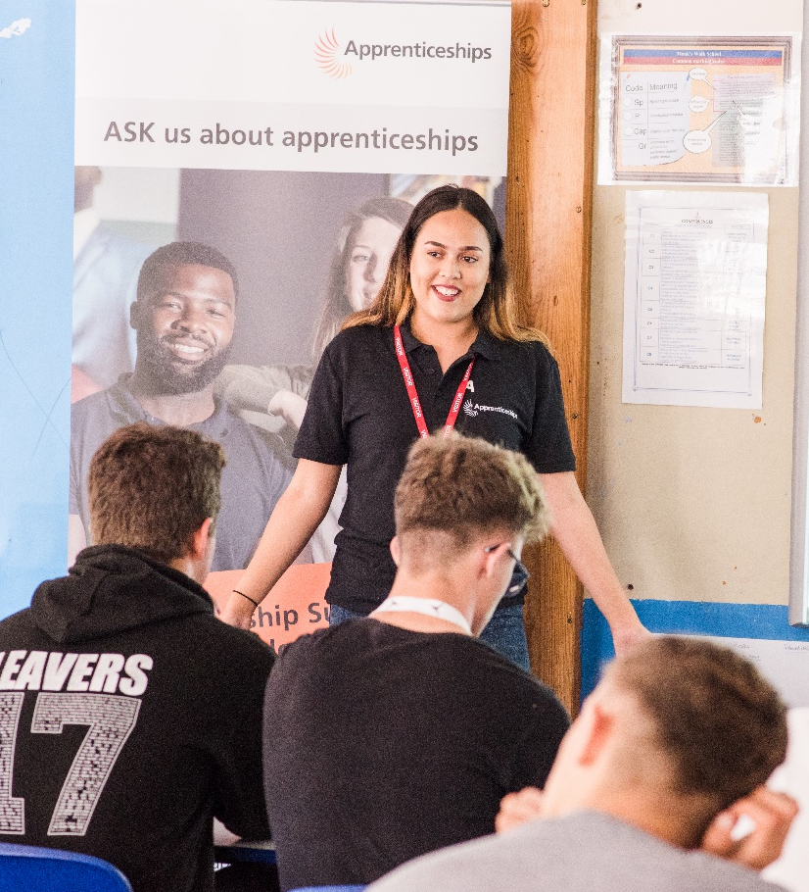
You can start an apprenticeship from the age of 16 (level 2) and work up towards achieving a degree (level 6 / 7)
EARN A
GAIN A
SALARY
DEGREE
90%
NO FEES
STAY IN
WORK
TO PAY
POST-APPRENTICESHIP
YOU CAN
Social life?
RELOCATE
Notes:
Presenter notes: Ask the audience a question: Does anyone know what apprentices are paid? (Typically you will get lots of different responses)
The first thing to remember is that as an apprentice, you get paid a salary.
Many people think that apprentices are low-paid, and this can be true, depending on the employer. Legally, an employer must pay an apprentice the National Minimum Wage for apprentices which is currently £3.90 per hour. This is lower than the normal National Minimum Wage, but it recognises that some people will be going into their first job with no experience at all.
The good news is that lots of employers pay a lot more than the National Minimum Wage for apprentices.
Some apprenticeship schemes in big organisations have a starting salaries of £15k. And some London based employers will pay even more than this.
Presenter notes: You might want to display local opportunity pay rates or need to adjust this message depending on the local area.
It’s important to remember that if you see an apprenticeship you’re interested in, don’t be put off by the pay if it’s low: there’s room for progression and working your way to the top of an organisation.
Another common myth is that once you’ve completed your apprenticeship, your employer will let you go. This isn’t true. The majority of apprentices (around 90%) stay in employment. If they do change companies, it’s usually because they’re able to compete for a better job, perhaps with more pay or more responsibility.
Lots of young people are worried that as an apprentice you won’t get to have fun or meet other young people. That isn’t true. Depending on the size of the company, you may find yourself working with lots of other young people. You can join the Young Apprentice Ambassadors programme and you will meet hundreds of other apprentices.
Another myth is that apprenticeships are only for people that don’t go on to full time uni. That’s not true – there are different levels of apprenticeships suited to everyone and you can go all the way up to degree level – so you’re still at uni but part time. I’ll tell you more about that later.
One of the best things about apprenticeships is that they are everywhere. So if you want to carry on living at home then you can, but you can sometimes move around the country with an apprenticeship. It’s really important to do your research – but some companies will help you to relocate to work for them.

Slide 4





The levels of apprenticeships
LEVEL
LEVEL
Intermediate
apprenticeship
Level 2
Advanced apprenticeship
Level 3
Higher apprenticeship
Level 4-7
Degree apprenticeship
Level 6 & 7
Intermediate
apprenticeship
Level 2
Advanced apprenticeship
Level 3
Higher apprenticeship
Level 4-7
Degree apprenticeship
Level 6 & 7
SKILLS, KNOWLEDGE & BEHAVIOURS
SKILLS, KNOWLEDGE & BEHAVIOURS
Notes:
We now have four apprenticeship levels: Intermediate, Advanced, Higher and degree.
If you want to, you can now start an apprenticeship with the potential to work all the way up to achieving a degree.
Higher apprenticeships cover all levels from 4 through to 7
Level 4, 5, 6 and 7 are equivalent to a Foundation Degree and above.
A degree apprenticeship contains a Level 6 or 7 Bachelors or Masters degree.
The level of apprenticeship you start at will depend on the kind of job that you are applying for. It’s really important not to be held back by only looking for a particular level e.g. degree apprenticeships, because it may be that you need to start at advanced or higher level and work your way up.
Doing a job is completely different to getting a GCSE or A Level and that’s why it can be a bit confusing.
Keep an open mind so that you can explore all of the opportunities available

Slide 5
Are you the next Apprentice?
https://www.youtube.com/watch?v=s0fcP0QgtGE
https://www.youtube.com/watch?v=guS6tQwU-tY

Slide 6
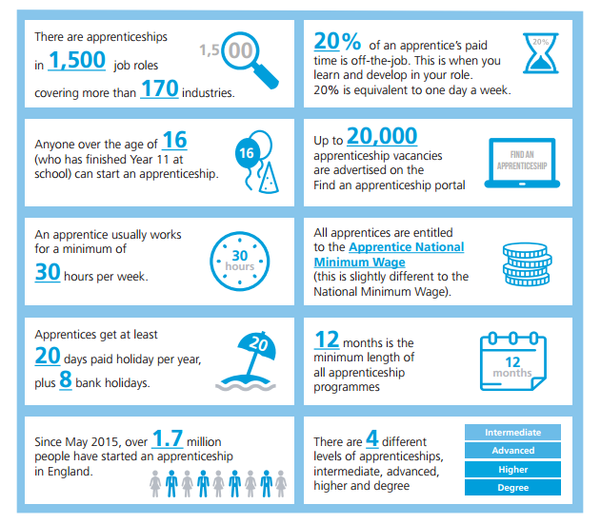

Slide 7

Mrs Watts – Careers Lead
Mr Knight – Careers Adviser
Your Tutor
Your Subject Teachers
Careers Information in the Library Hub
QPHS website
Follow the National Apprenticeship Service:
@Apprenticeships
Search for apprenticeships on GOV.UK or call 08000 150 400
Look on company websites to see what they offer
Where can I get Careers Information Advice & Guidance from?

Slide 8
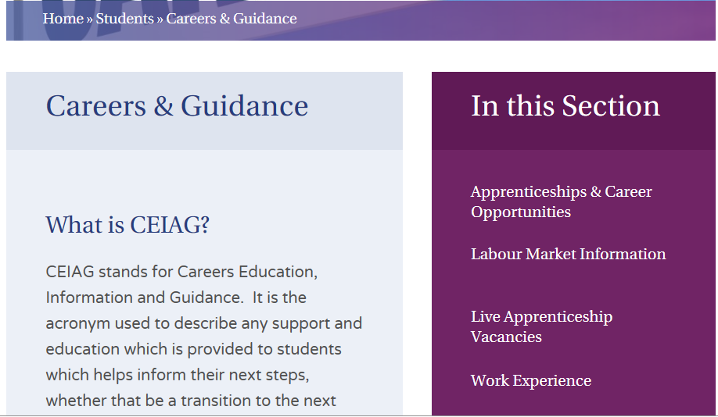
Home >> Students >> Careers & Guidance

Slide 9
Are you fired up?
https://youtu.be/Y2gDzrUmB5k

Slide 10
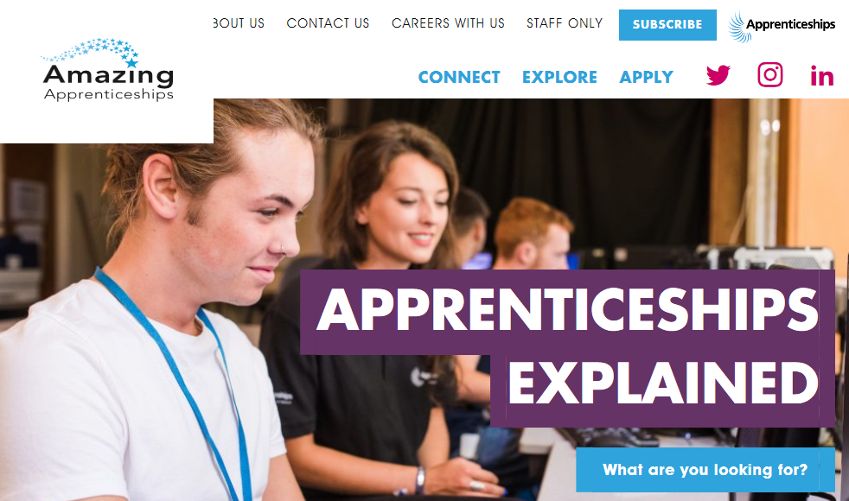
https://amazingapprenticeships.com

